Slide 1
From Variant to Value:
Ultrarare Syndromes with a Skeletal Dysplasia Flair
Rare Disorders Research Forum
5-6 August 2026
Patrick Yap, MD Candidate
Faculty of Medical & Health Sciences
Molecular Medicine & Pathology
University of Auckland

Slide 2
Overview
Introduction & update on MD projects based on rare syndromes
Passion for Skeletal Dysplasias
  ATP2B1
  GRK2
From Variant to Value (Genomic MDM in clinical care of patients with rare disorders)

Slide 3
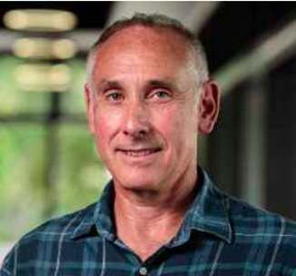
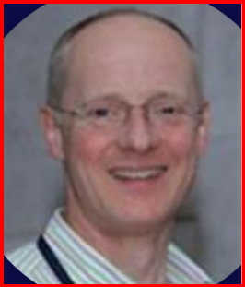
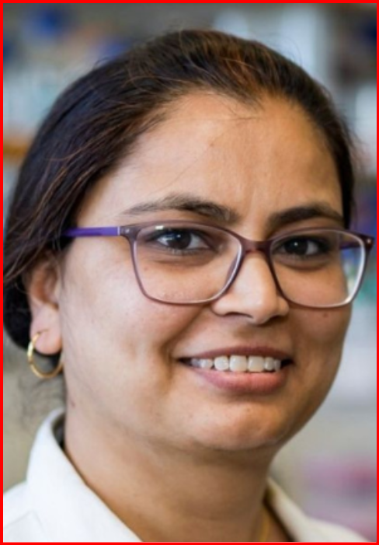
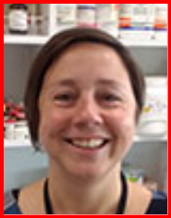
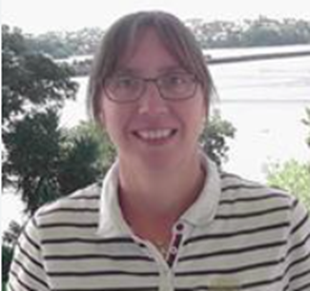
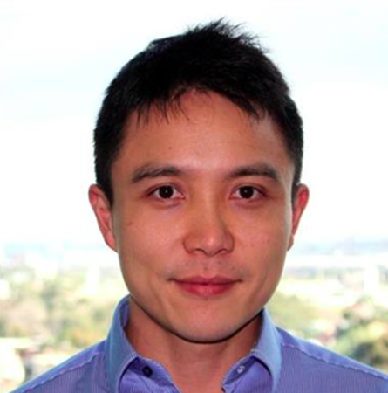

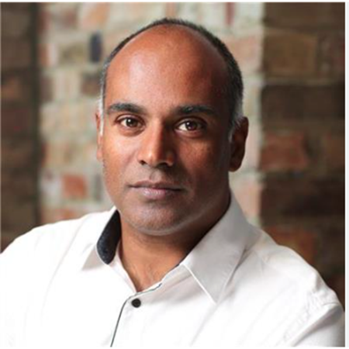
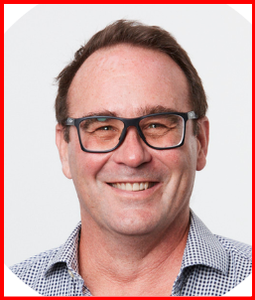
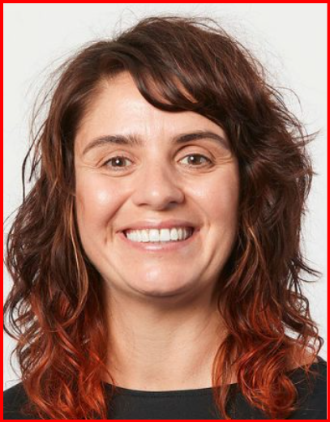
Summary of MD Projects
Undiagnosed syndromes
Funded by Genomics Into Medicine/Rakeiora Initiative, Precision Medicine Initiative
HDEC 18/CEN/62
20 trio exome – 10/20 solved
Novel - ATP2B1, TMEM26, HIST1A2AC
GRK2 – functional validation and phenotype expansion
Progress – Unsolved cases for WGS (HDEC )
Ultra-rare trio exome (URTE)
Genomic insight into NIHF (GIHF)
Newborn Genomics (NBG-ONT)
Pregnancies and newborns affected by NIHF
Funded by GIM, Maurice & Phyllis Paykel Trust
HDEC 19/NTA/41
17 trio exome – 9/17 solved
Novel – FLNC
Progress – Unsolved cases for WGS (HDEC )
Clinical implementation of rapid genomic diagnosis in acute setting (NICU & PICU)
Validation phase (independent, parallel seq with VCGS) – facilitation of MDT process
100% concordance (ONT vs Illumina), 60% diagnosis
Survey – Participant Perception on Value & Feasibility of Genomic MDT

Slide 4
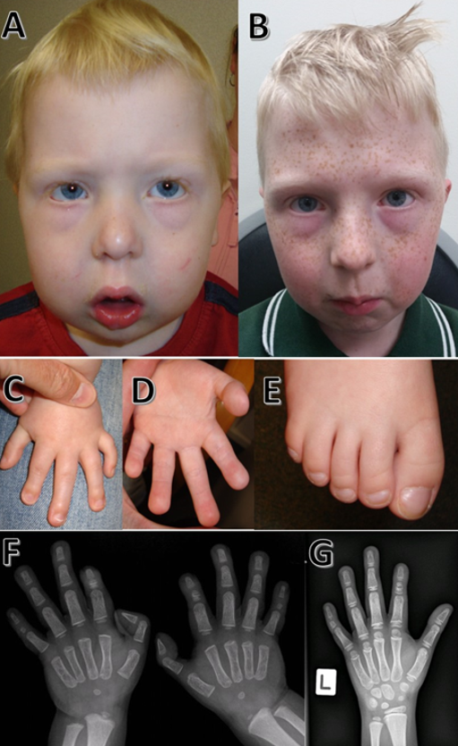
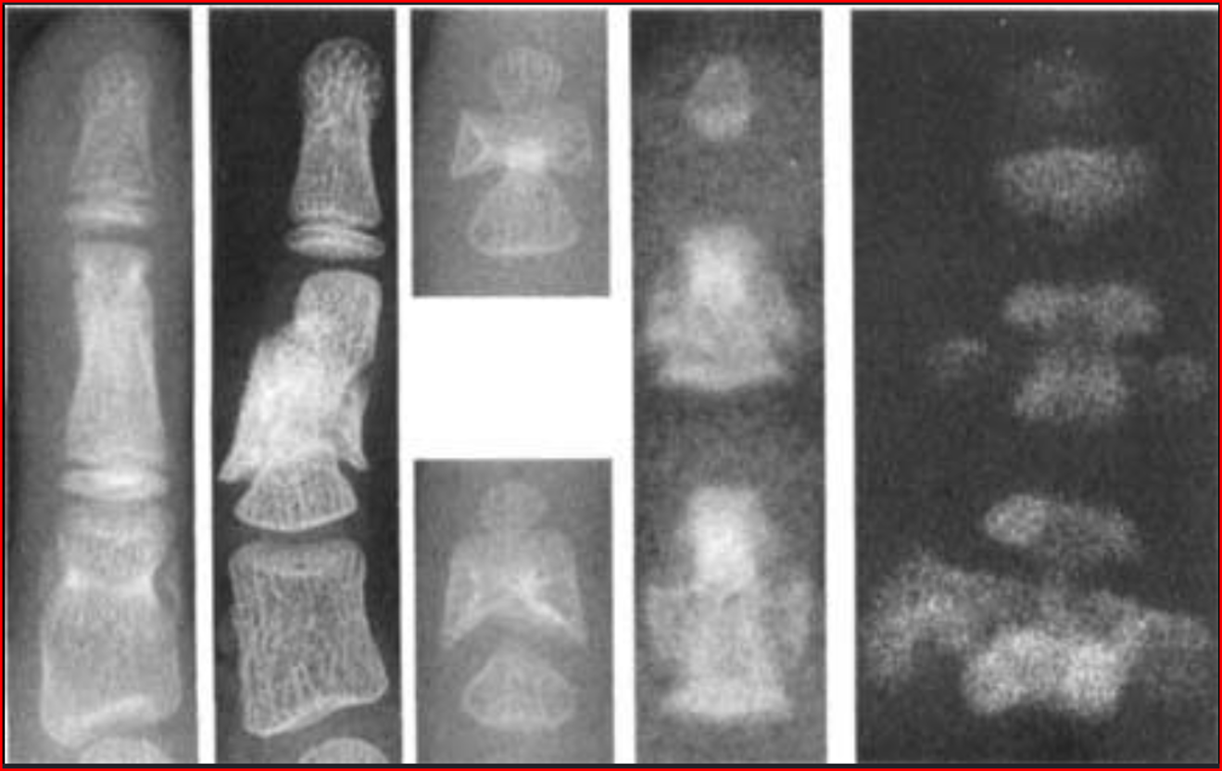
Case 1 – Novel gene association
Non-consanguineous healthy Caucasian parents - reproductive risk clarification
Phenotype:
  Distinctive craniofacial gestalt -Pierre-Robin sequence
  Neurodevelopmental and growth deficit
  Periventricular nodular heterotopia (asymmetrical)
  Brachymesophalangy, cutaneous syndactyly
  Persistent subclinical hypocalcaemia from primary hypoparathyroidism

Slide 5
Proband-parent trio exome
Compound heterozygous variants
NM_001366521.1 (ATP2B1)
  Splice c.3060+2T>G (mat)
  Missense c.2938G>T, p.(Val980Leu) (pat)
ATP2B1
Role in calcium homeostasis
Crucial for neurogenesis & neurotransmission (embryogenesis)
Bone mineralisation (reduced iPTH)
Cardiovascular contractility
Haploinsufficiency -> ID + epilepsy (variably expressed)
Call a friend!
Prof Sandra Cooper (Sydney)
Gene-Matcher

Slide 6
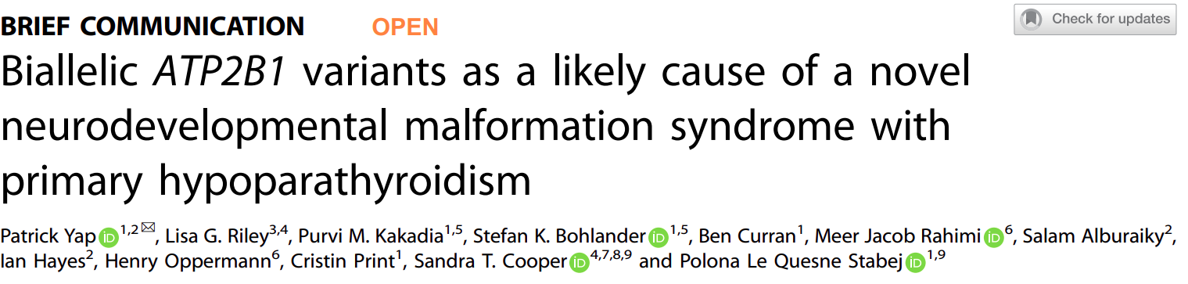
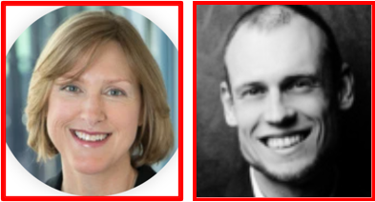
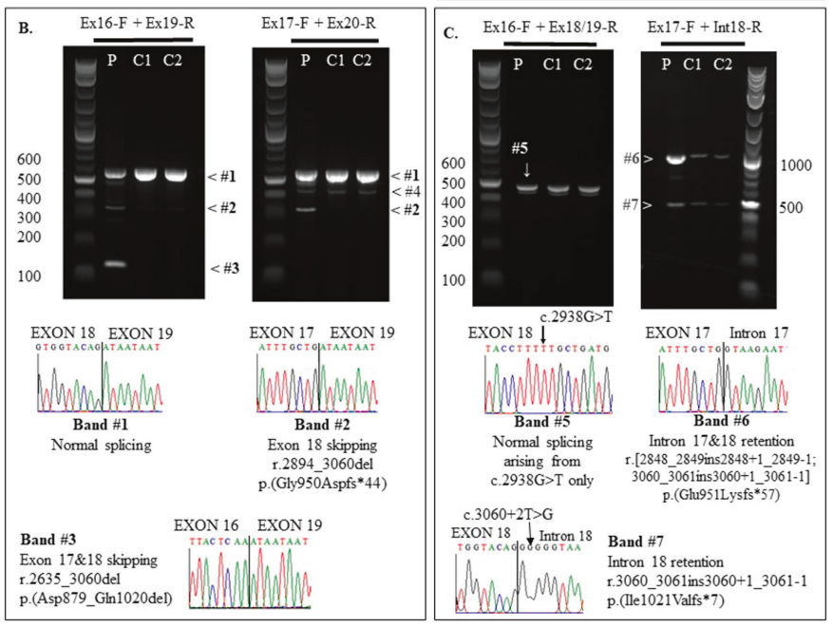
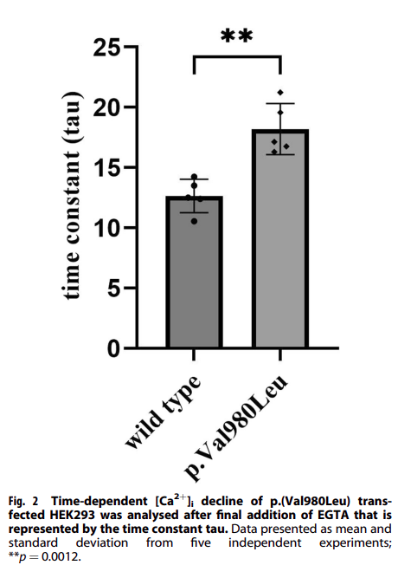

Slide 7
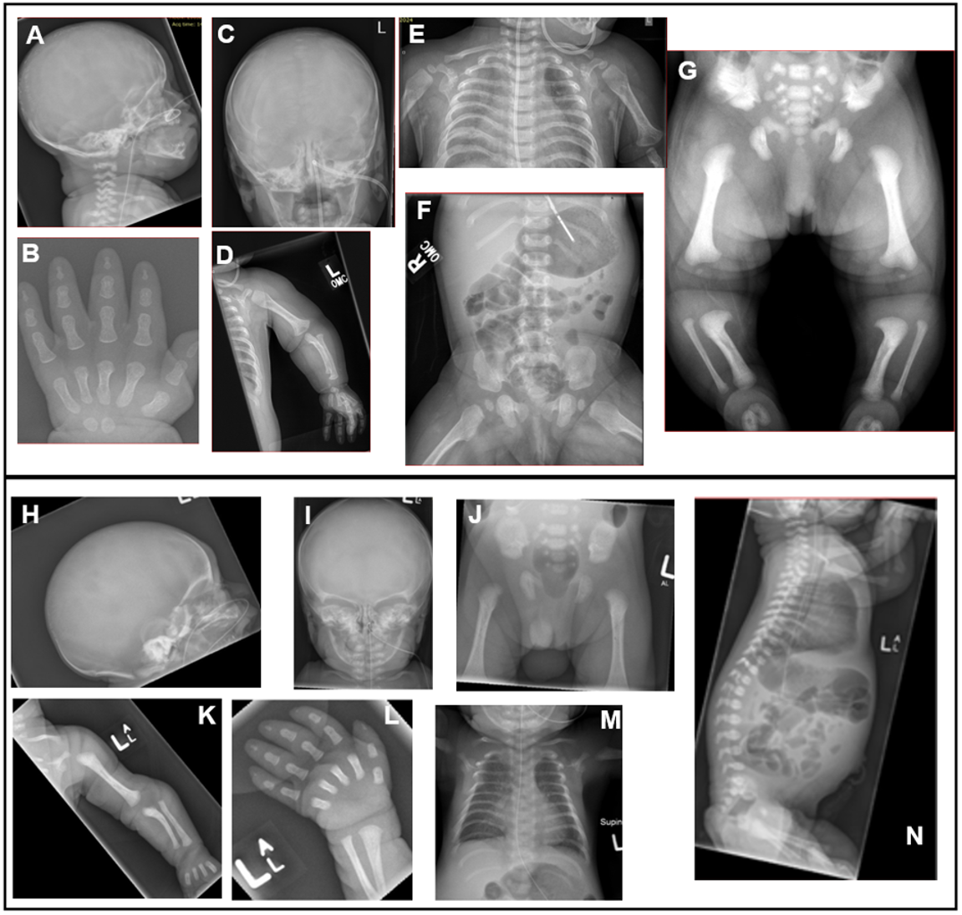
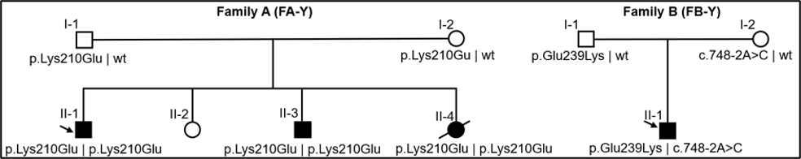
Case 2 – Functional characterisation & phenotype expansion
Family A (NZ) – homozygous GRK2 missense variant
  K210E
Family B (Aus) – com het GRK2 variants (splice + missense)
  E239K
  c.748-2A>C

Slide 8
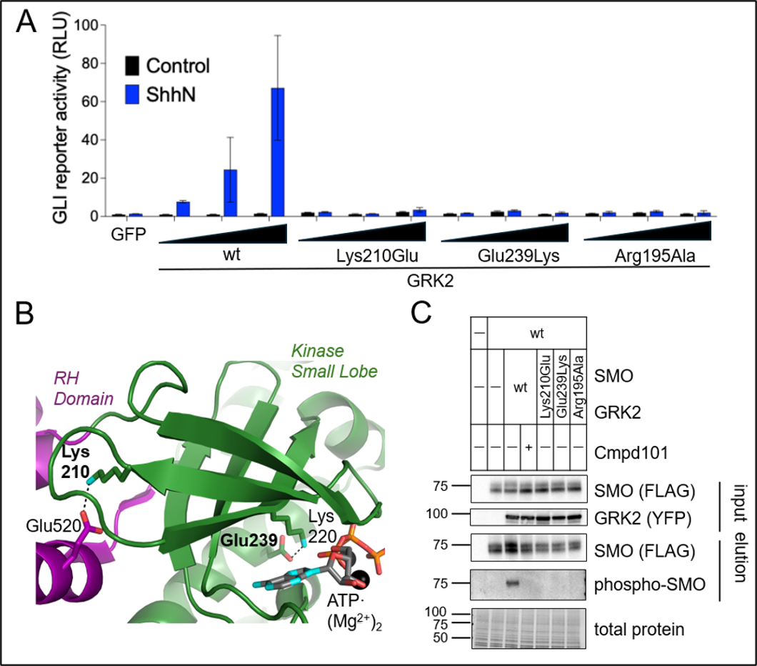
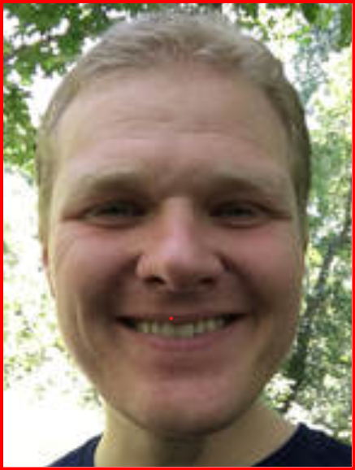
Functional validation (GRK2 missense variants)
B Myers
University of Utah
GRK2
  Hh signaling - SMO-phosphorylation activates down-stream GLI transcription
  biallelic Short rib thoracic dysplasia (Bosakova et al, 2020) – 3 patients from 2 families
E210K & K239E impair the catalytic effect of GRK2 (reduced SMO-phosphorylation)

Slide 9
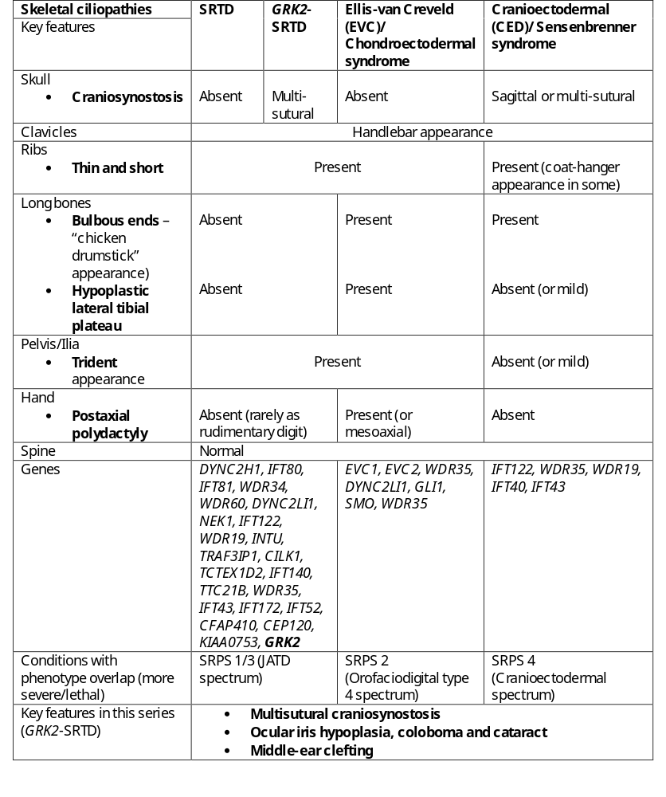
Functional Characterization of Novel GRK2 Missense Variants and Phenotypic Expansion on GRK2-related Short-Rib Thoracic Dysplasia
Patrick Yap^{1#}, Zoe Ward^{1,2#}, Ollie Amakon³*, Simran Sidhu³*, Elaine Zhang^{4,5}, Purvi M. Kakadia⁶, Michael Gattas⁷, Rachel Austin⁷, Megan Leask⁸, John Christodoulou^{4,9}, Australian Undiagnosed Disease Network (UDN-Aus) Consortium¹⁰, John J. G. Tesmer¹¹, Cristin G. Print^{1,2}, Stefan K. Bohlander⁶, Benjamin R. Myers^{3$}, Polona Le Quesne Stabej^{1$}
Multi-sutural craniosynostosis
Iris hypoplasia, coloboma, cataract
Middle-ear cleft (HL)
Cardiomyopathy

Slide 10
Genomic MDT Meeting in NZ
Pros | Cons
Effectiveness Efficiency Appropriateness Safety Timeliness Familiar/Acceptable Promote collaboration Readily available Freedom (participant) Sustainability Platform for education/upskill Cost effective – cheaper than multiple outpatient clinics | Clinician’s valuable time Confidentiality (consent required) Hard to control who turned up Confronting/intimidating Time for prep Conflicting opinions Genomic knowledge gap among participants
Clinical Genomic MDT Meeting in New Zealand (2019 – 2025)
National Genomic MDT meetings monthly
Funded by GIM/Rakeiora Initiative led by C Print
Hosted by GHSNZ – all three labs, researchers, international experts, subspecialists
Local subspecialty genomic MDT meetings – Starship Hospital, Auckland City Hospital
Forms the foundation for Newborn Genomics Programme

Slide 11
The Value & Feasibility of MDT Meetings
Conclusion to MD Thesis
Survey Study based on Ma et al.,2024 and Nyaga et al.,2024
Participant Perception on the Value and Feasibility of Genomic Multidisciplinary Team (MDT) Meetings

Slide 12
Publication in Peer-reviewed Journal
First author
Denis M. Nyaga, Peter Tsai, Clare Gebbie, Hui Hui Phua, Patrick Yap, Polona Le Quesne Stabej, Sophie Farrow, et al. Benchmarking and quality control for Nanopore sequencing and feasibility of rapid genomics in New Zealand: validation phase at a single quaternary hospital; medRxiv (2024).06.13.24307636; doi: https://doi.org/10.1101/2024.06.13.24307636
Yap, P., Riley, L.G., Kakadia, P.M. et al. Biallelic ATP2B1 variants as a likely cause of a novel neurodevelopmental malformation syndrome with primary hypoparathyroidism. Eur J Hum Genet 32, 125–129 (2024). https://doi.org/10.1038/s41431-023-01484-9
Senior author
Alburaiky S, Taylor J, O'Grady G, Thomson G, Perry D, England E M, & Yap P. Cochlear nerve deficiency in SOX11-related Coffin–Siris syndrome. American Journal of Medical Genetics, Part A, 188(8), 2460–2465 (2022)
Henry A, Rajasekaran V, Evans HM, Strauss M, Patel R, Greenslade M, Roberts AJ, Yap P. An Atypical Case of Very Early-onset Familial Adenomatous Polyposis Associated With Focal Cortical Dysplasia. J Pediatr Hematol Oncol; 44(3):e743-e746 (2022), doi: 10.1097/MPH.0000000000002256. PMID: 34310467
Co-author (second/third)
Gordon H, Yap P, Hsiao K-C, Watson M, Purvis D. A novel pathogenic variant in the corneodesmosin gene causing generalized inflammatory peeling skin syndrome with marked eosinophilia and trichorrhexis invaginata. Pediatr Dermatol. 2022; 39: 268–272. doi:10.1111/pde.14939
Sibbin, K., Yap, P., Nyaga, D., Heller, R., Evans, S., Strachan, K., Alburaiky, S., Nguyen, H. (A.), Hermann-Le Denmat, S., Ganley, A. R. D., O'Sullivan, J. M., & Bloomfield, F. H. (2022). A de novo ACTB gene pathogenic variant in identical twins with phenotypic variation for hydrops and jejunal atresia. American Journal of Medical Genetics Part A, 188A: 1299–1306. https://doi.org/10.1002/ajmg.a.62631
Co-author
Ariyama, H., Tsukamura, A., Miyatake, et. al. The mTOR-Dop1a-Agpat2 axis regulates nuclear phospholipid homeostasis, iScience (2026), doi: https://doi.org/10.1016/j.isci.2026.115860.
Hayashi, Y., Kajiwara, K., Mizuno, S. et al. Monoallelic and biallelic RNU4-2 variants in neurodevelopmental disorders. J Hum Genet 71, 327–334 (2026). https://doi.org/10.1038/s10038-025-01442-x
Hull, S., Sheck, L., Braatvedt, G., Mouat, F., Jefferies, C., Yap, P., et. al. Vincent, A. L. (2024). The phenotypic spectrum of syndromic optic atrophy associated with variants in WFS1: with reclassification of p.Val606Gly as a likely benign variant. Ophthalmic Genetics, 1–8. https://doi.org/10.1080/13816810.2024.2426561
Miyake, N., Tsurusaki, Y., Fukai, R. et al. Molecular diagnosis of 405 individuals with autism spectrum disorder. Eur J Hum Genet 32, 1551–1558 (2024). https://doi.org/10.1038/s41431-023-01335-7
Savarirayan R, Hoover-Fong J, Yap P et al. New treatments for children with achondroplasia.The Lancet Child & Adolescent Health, 8, 301-310
Zelha N, Deshwar A, Huang Y, et. al. Rare de novo gain-of-function missense variants in DOT1L are associated with developmental delay and congenital anomalies The American Journal of Human Genetics, Volume 110, Issue 11, 1919 – 1937 (2023)
Shoubridge C, Dudding-Byth T, Pasquier L, Goel H, Yap P, McConnell V. IQSEC2-related encephalopathy in males due to missense variants in the pleckstrin homology domain. Clinical Genetics. 2022; 102(1): 72-77. doi:10.1111/cge.14136
Whalen S, Shaw M, Mignot C, et. al. Further delineation of BCAP31-linked intellectual disability: description of 17 new families with LoF and missense variants. Eur J Hum Genet, 2021 Feb 18. doi: 10.1038/s41431-021-00821-0 .
Brunet T, McWalter K, Mayerhanser K, et. al. Defining the genotypic and phenotypic spectrum of X-linked MSL3-related disorder. Genet in Med 2020; 23: 2.
Byrne A B, Mizumoto S, Arts P, Yap P, et al. Pseudodiastrophic dysplasia expands the known phenotypic spectrum of defects in proteoglycan biosynthesis. J Med Genet 2020;0:1–7. doi:10.1136/jmedgenet-2019-106700.
Sekiguchi, F., Tsurusaki, Y., Okamoto, N., et al. Genetic abnormalities in a large cohort of Coffin–Siris syndrome patients. J Hum Genet 64, 1173–1186 (2019). https://doi.org/10.1038/s10038-019-0667-4.
Costantini A., Valta H., Baratang N., Yap P. et al. Novel fibronectin mutations and expansion of the phenotype in spondylometaphyseal dysplasia with “corner fractures”. Bone 2018. Accepted for publication 30 December 2018.
Gordon H, Yap P, Hsiao K-C, Watson M, Purvis D. A novel pathogenic variant in the corneodesmosin gene causing generalized inflammatory peeling skin syndrome with marked eosinophilia and trichorrhexis invaginata. Pediatr Dermatol. 2022; 39: 268–272. doi:10.1111/pde.14939
Sibbin, K., Yap, P., Nyaga, D., Heller, R., Evans, S., Strachan, K., Alburaiky, S., Nguyen, H. (A.), Hermann-Le Denmat, S., Ganley, A. R. D., O'Sullivan, J. M., & Bloomfield, F. H. (2022). A de novo ACTB gene pathogenic variant in identical twins with phenotypic variation for hydrops and jejunal atresia. American Journal of Medical Genetics Part A, 188A: 1299–1306. https://doi.org/10.1002/ajmg.a.62631

Slide 13



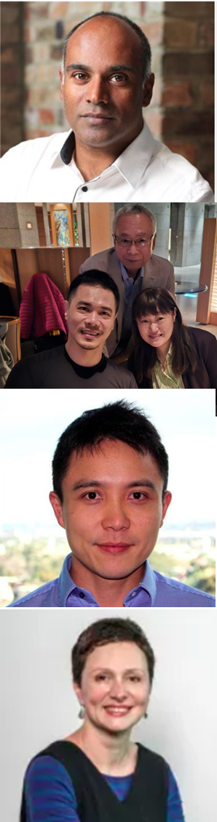





Acknowledgement
Patients and Families
University of Auckland
Print Lab - Prof. C Print, Dr P Le Quesne Stabej, Dr Z Ward
Bohlander Lab – Prof S Bohlander, Dr P Kakadia
Liggins Institute – Prof J O’Sullivan, Dr J Van Dyk
Dr H Wihongi – Maori Health Research
Te Whatu Ora Te Toka Tumai Auckland
Genetic Health Service New Zealand (Auckland)
Maternal-Fetal Medicine, ACH
Starship Children Hospital
Starship Foundation Clinical Trial Support
Diagnostic Genetics, LabPlus, Auckland City Hospital
M Woodnorth (Research Office)
Victorian Clinical Genetic Services, Murdoch Childrens Research Institute, Melbourne, Australia
Prof R Savarirayan
Prof Z Stark
Prof TY Tan
Undiagnosed Disease Network - Australia
International Collaborators
Prof G Nishimura (Japan)
Prof S Cooper & Dr L Riley (Sydney, Australia)
Prof H Opperman & Dr MJ Rahimi (Lepzig, Germany)
Prof B Myers (Utah, USA)
THANK YOU!

